Slide 1
^{Chapter 4} Hash Tables
ZAMAN UNIVERSITY
Data Structures and Algorithms

Slide 2
Deletion
When deleting records from a hash table, there are two important considerations:
Deleting a record must not hinder later searches – thus, the search process must still pass through the newly emptied slot to reach records whose probe sequence passed through this slot. The delete process cannot simply mark the slot as empty, because this will isolate records further down the probe sequence;
We do not want to make positions in the hash table unusable because of deletion. The freed slot should be available to a future insertion.
Both of these problems can be resolved by placing a special mark in place of the deleted record, called a tombstone.

Slide 3
Deletion: tombstone
The tombstone indicates that a record once occupied the slot but does so no longer
If a tombstone is encountered when searching through a probe sequence, the search procedure is to continue with the search
When a tombstone is encountered during insertion, that slot can be used to store the new record
However, to avoid inserting duplicate keys, it will still be necessary for the search procedure to follow the probe sequence until a truly empty position has been found. And the new record would actually be inserted into the slot of the first tombstone encountered.

Slide 4
Deletion: Solutions
Two possible solutions for deletions:
Do a local reorganization upon deletion to try to shorten the average path length. For example, after deleting a key, continue to follow the probe sequence of that key and swap records further down the probe sequence into the slot of the recently deleted record
Periodically rehash the table by reinserting all records into a new hash table. Not only will this remove the tombstones, but it also provides an opportunity to place the most frequently accessed records into their home positions

Slide 5

Create deletion functions (for linear and quadratic probing) based on idea of Tombstone Local Reorganization

Slide 6
Outline
Hash Tables
Quadratic Probing
Separate Chaining
When to Use What

Slide 7
Outline
Hash Tables
Quadratic Probing
Separate Chaining
When to Use What

Slide 8
Separate Chaining
Collisions are resolved by looking for an open cell in the hash table
In separate chaining a linked list is installed at each index in the hash table;
A data item’s key is hashed to the index in the usual way, and the item is inserted into the linked list at that index;
Other items that hash to the same index (collisions) are simply inserted in the same linked list;
there’s no need to search for empty cells in the primary array.

Slide 9
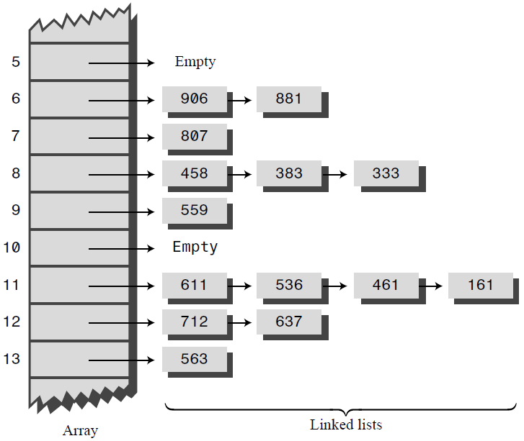
Example of Separate Chaining

Slide 10
Create a Hash Table with size 20
Words are converted to number by Multiply Powers;
Solve collision problem with Separate Chaining

Slide 11
Outline
Hash Tables
Quadratic Probing
Separate Chaining
When to Use What

Slide 12
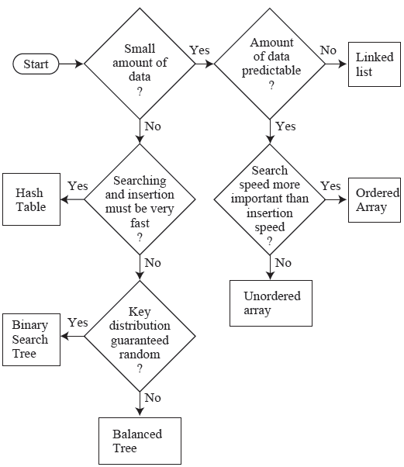
General-Purpose Data Structures

Slide 13
Comparing Storage Data Structures
Data Structure | Search | Insertion | Deletion
Array | O(N) | O(N) | O(N)
Ordered Array | O(log N) | O(N) | O(N)
Linked List | O(N) | O(1) | O(N)
Order Linked List | O(N) | O(N) | O(N)
Stack | - | O(1) | O(1)
Queue | - | O(1) | O(1)
Priority Queue | - | O(N) | O(1)
Hash Table | O(1) | O(1) | O(1)

Slide 14
Comparison of Sorting Algorithms
Sort | Average | Worst | Extra Memory
Bubble | O(N²) | O(N²) | No
Insertion | O(N²) | O(N²) | No
Quicksort | O(N*log N) | O(N²) | No
Mergesort | O(N*log N) | O(N*log N) | Yes

Slide 15
End of Chapter IV – Hash Table

